Slide 1
Weather Forecasting Tool
Microsoft – GitHub Copilot Hackathon 2023
Submitted By: Aryan Ajay Kumar

Slide 2


Situation Overview
Introduction
Imagine having a useful tool at your disposal that quickly provides you with current weather reports for any city on the planet. Welcome to our state-of-the-art weather forecasting tool, where precision and simplicity coexist in graceful harmony.
Source: https://www.td.org
Our tool, which is driven by the ingenuity of GitHub Copilot, makes quick API requests, pulls essential weather data smartly, and displays the current weather report for the city of your choice. You can tell if rain is forecast, the sky are clear, or there is a light breeze blowing through the streets with just a quick glimpse.
Source: https://play.google.com

Slide 3


Situation Overview
Problem Statement
We focus on the fundamental issue of the absence of an easily usable instrument that streamlines the process of getting meteorological data. Conventional approaches often involve visiting multiple websites, navigating complex interfaces, and struggling with outdated or convoluted data.
Source: https://kalimpongonlinenews.blogspot.com/
By offering a single, user-friendly platform that quickly produces accurate weather forecasts with only a few clicks, our technology aims to reduce these frustrations.
Source:https://letstalkscience.ca

Slide 4



Softwares Used
Visual Studio Code
GitHub Copilot
OpenWeatherMap API
Visual Studio Code, brought to you by the tech giant Microsoft, is a masterpiece of development software designed to revolutionize the way programmers work.
GitHub Copilot, an innovation born from the collaboration of GitHub and OpenAI, is an extraordinary tool designed to revolutionize the way developers write code.
The OpenWeatherMap API is a comprehensive and versatile platform that provides developers with access to a wealth of weather-related data.

Slide 5
Code Explanation
The code imports the necessary libraries, ‘requests’ and ‘json’, which are used for making HTTP requests and handling JSON data respectively.
An API key from OpenWeatherMap is used along with an API URL.
A function is defined with the city name as an argument for which the weather forecasting is done.
The code retrieves the weather description from the extracted data and stores it in a variable.
The current weather forecast for a specified city is displayed with huge support from GitHub Copilot, OpenWeatherMap API and Visual Studio Code.

Slide 6
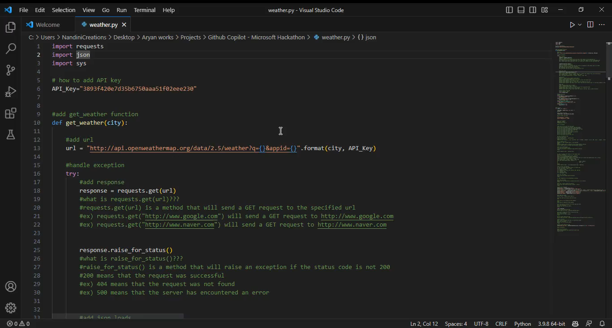
Methodology using GitHub copilot
Code Link

Slide 7
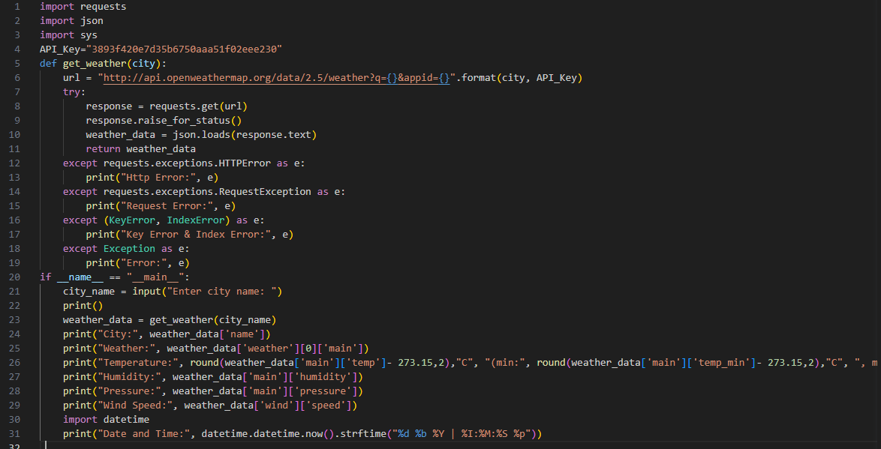
Clean Code with No Comments
Code Link

Slide 8
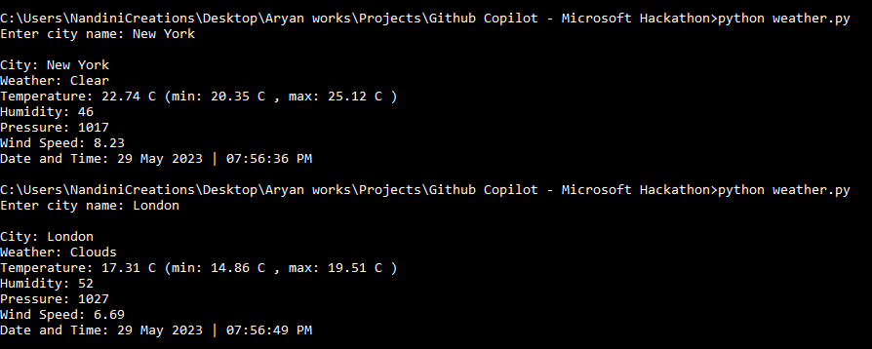
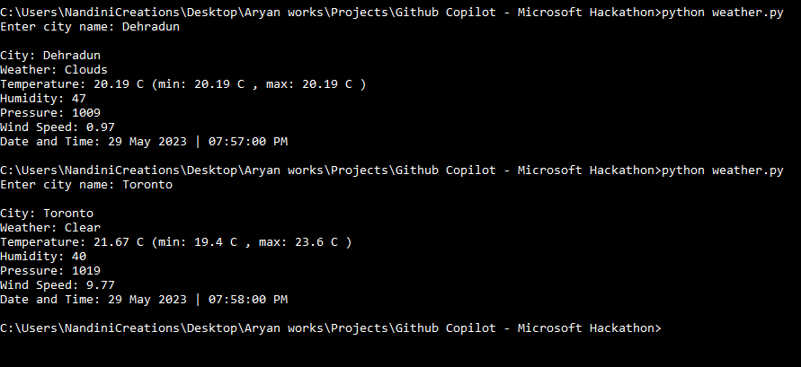
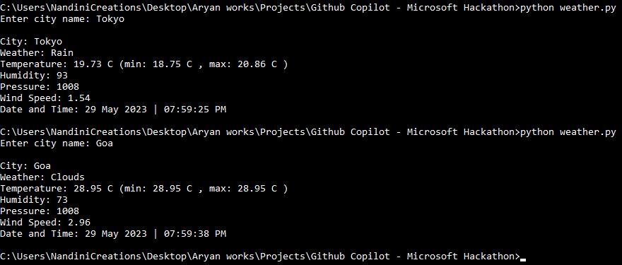
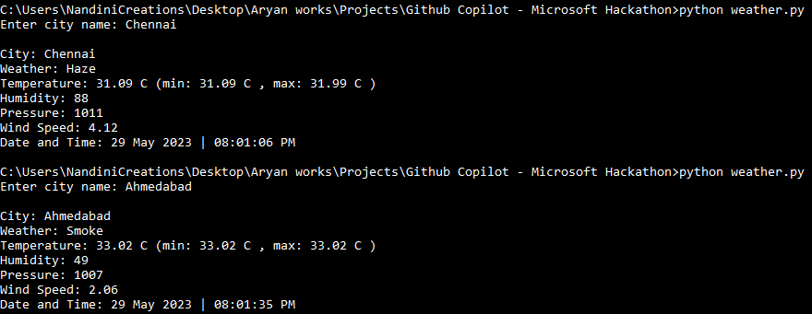
Command Line Implementation

Slide 9

Conclusion
In conclusion, the weather forecasting tool presented here harnesses the power of the OpenWeatherMap API to provide real-time weather forecasts for any city worldwide. With a simple command-line interface, users can easily retrieve the current weather description for their desired location.
The code utilizes the ‘requests’ library for API requests and the ‘json’ library for data parsing. Error handling is implemented to ensure smooth execution, and GitHub Copilot assists in enhancing code efficiency. By offering accuracy, simplicity, and seamless integration, this tool empowers users to make informed decisions and stay ahead of changing weather conditions.
Source: https://www.indiaweatherblog.com

Slide 10


